Slide 1
ADVANCED PROGRAMMING-ITIC 2223
Lecture 06- Loops
Ramesh Madhuranga
MPhil.(Reading) (USJP), BICT (Hons) (RUSL), AMCSSL
Department of Biosystems Technology
Faculty of Technology
Kotelawala Defence University

Slide 2
What is a Loop?
A loop is an instruction that repeats multiple times as long as
some condition is met.
When the condition becomes false, the loop ends and the program control is passed to the statement following the loop

Slide 3
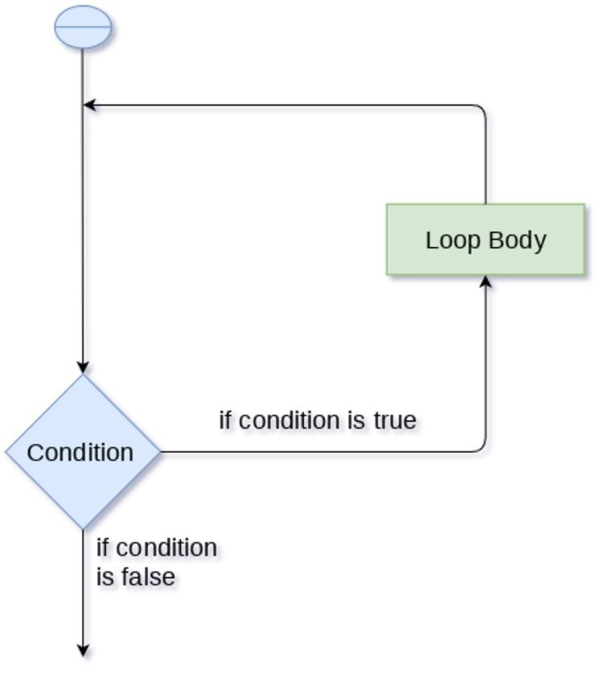
Working of a Loop statement.
3

Slide 4
Why We Use Loops in Python?
The looping simplifies the complex problems into the easy ones
E.g. Amal needs to print the first 10 natural numbers.
Then, instead of using the print statement 10 times, he can print inside a loop which runs up to 10 iterations.

Slide 5
Advantages of Using Loops in Python
It provides code re-usability.
Using loops, no need to write the same code again and again.
Using loops, we can traverse over the elements of data structures (array or linked lists).

Slide 6
Loop Statements in Python
Loops
While
Loop
For
Loop
Nested
Loop

Slide 7
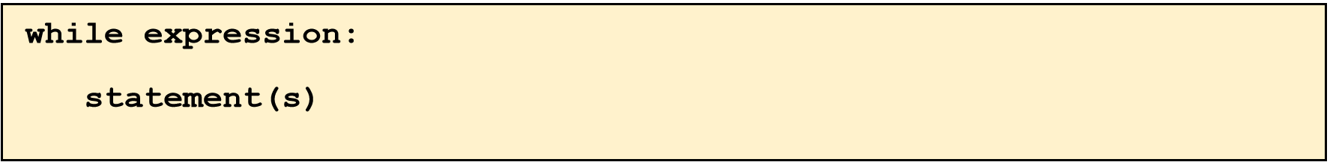
While Loop
The syntax of the while loop is:
At first expression is evaluated. If expression is true then the statement(s)
block is executed repeatedly until the expression becomes false.
Here the expression must return either true or false value.

Slide 8
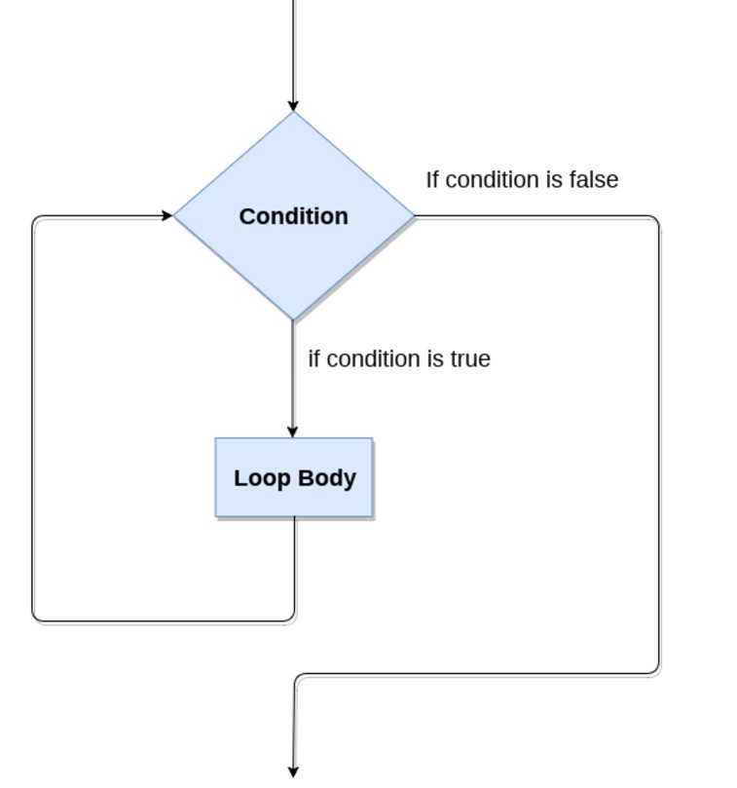
Working of a While Loop statement

Slide 9
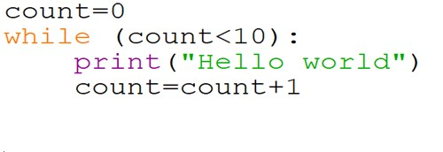

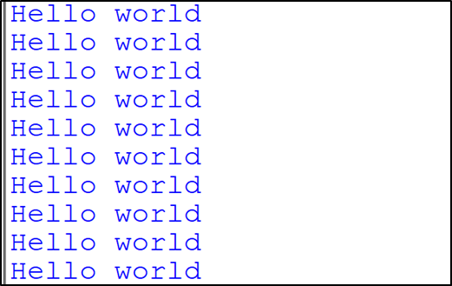
Examples for While Loop in Python
Example - 1: Print Hello World 10 Times
9

Slide 10
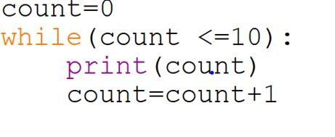
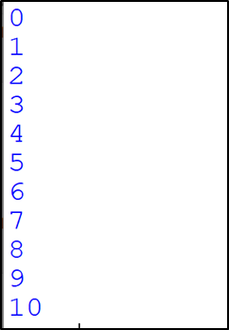
Examples for While Loop in Python
Example - 2: Print numbers from 0 to 10

Slide 11
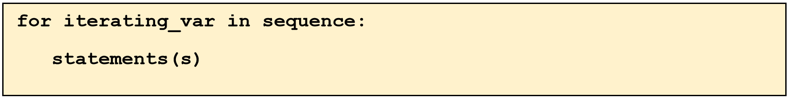
For Loop
For loop is used to iterate over a sequence, which could be a list, tuple or string.
The syntax of the for loop is:

Slide 12
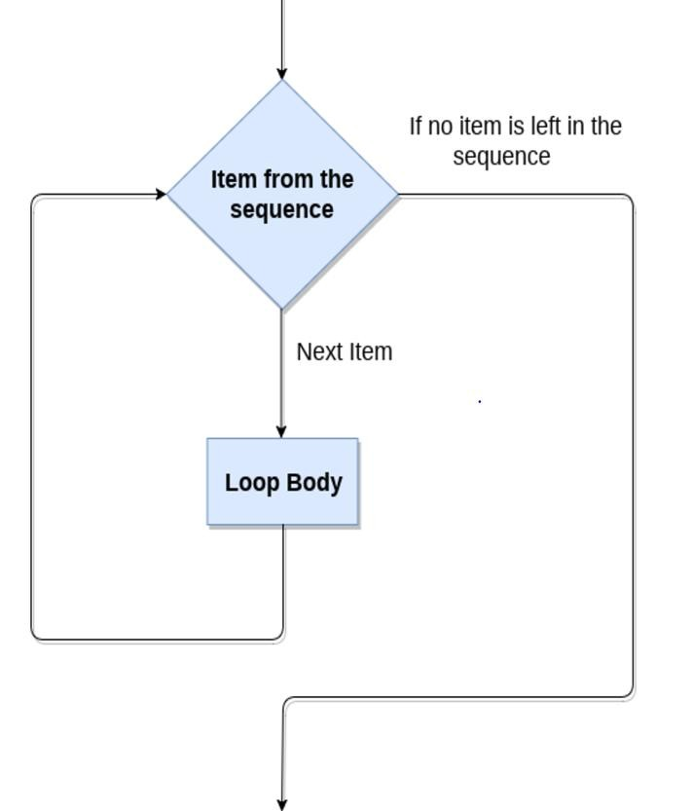
Working of a For Loop statement

Slide 13
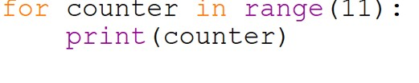
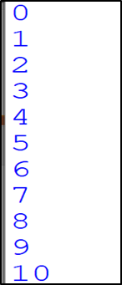
Examples -For Loop in Python
Example - 1: Print Numbers from 0 to 10

Slide 14
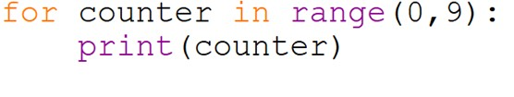

Examples- For Loop in Python
Example - 2: Print Numbers in range of 0 to 9

Slide 15
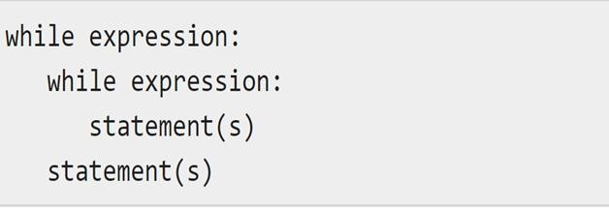
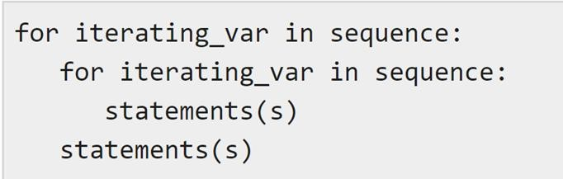
Nested Loops in Python
Python programming language allows to use one loop inside another loop.
Syntax:-
While Loop | For Loop

Slide 16
Exercises
While Loop:-
Question 01: Print Python word, 7 times
Question 02: Print numbers from 0 to 20
For Loop:-
Question 01:
Print numbers from 0 to 50
Question 02:
Print odd numbers from 0 to 50

Slide 17
Any Questions?
HAVE A NICE DAY!

